Slide 2
#커피미업 센서리랩 (마포)
#커피미업 로스팅랩 (가산)
#커피인쇄소 (을지로)

Slide 3
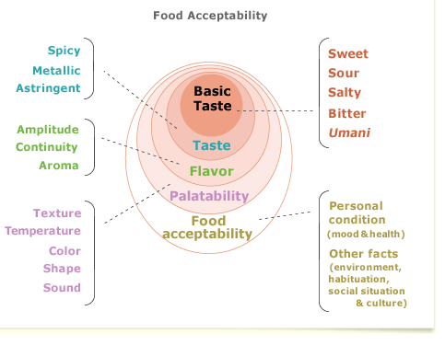

Slide 4
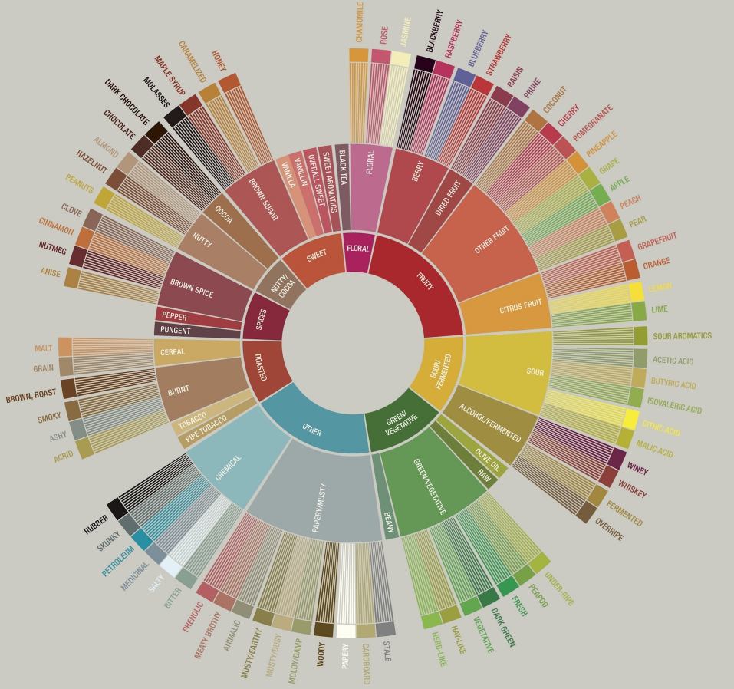

Slide 5
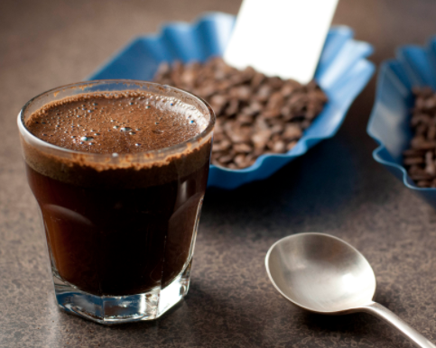
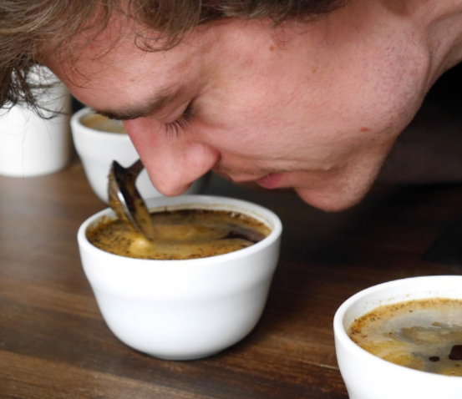
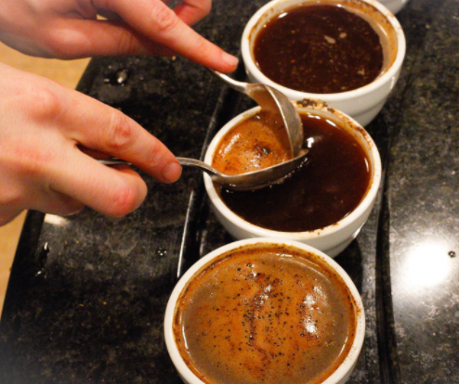
- 환경 : 좋은 채광, 조용함, 테이블, 온도
- 추출 : 골든컵 규정에 따라 최적의 추출율로 진행
- 로스팅 : 8-12분 사이의 샘플로스팅, 아그트론(홀빈58, 그라인드 63)
- 원두의 상태 : 미디엄-미디엄 라이트, 원두가 타거나 끝이 탄 Tipping이 없어야 함
- 원두 보관 : 20도 이상 상온에서 보관, 8-24시간 이내 커핑
- 추출 : 물 1ml 당 0.055g의 원두를 사용 (125-175ppm, 92-97도의 물 사용)
- 분쇄 : 디팅 or 말코닉 그라인더로 US매쉬 시브 사이즈 20에 70-75% 통과하도록
- 샘플 : 1종류 당 5컵 이상을 준비 (CoE는 4컵)
- 분쇄 후 원두 관리 : 15분 이내에 물 붓기, 유리커버가 있을 경우 30분까지 허용
- 시향 및 시음 방법 : Sniffing / Slurping 사용
- 시작 전 : 분쇄 향기 체크 (Dry Aroma, Fragrance)
- 0-4분 : 물 붓기 (CoE는 Crust를 통한 Wet Aroma 확인)
- 4-6분 : 브레이킹하며 아로마 체크 후 스키밍
- 12-17분(Hot) : 69-73도
- 17-22분(Warm) : 58-62도
- 22-27분(Cool) : 37도 (CoE는 보통 40분 정도까지 체크)

Slide 6
스페셜티 기준
SCA : 80점 이상
CoE : 86점 이상
CoE National Winner : 84~85.99점
CoE Presidential : 90점 이상

Slide 7
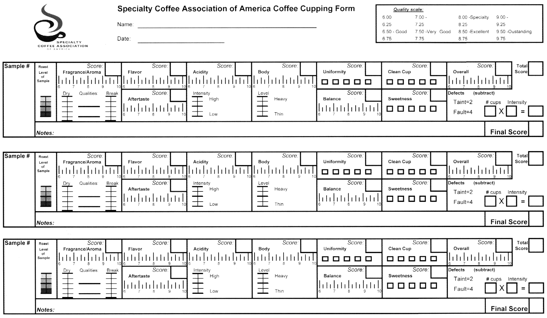

Slide 8
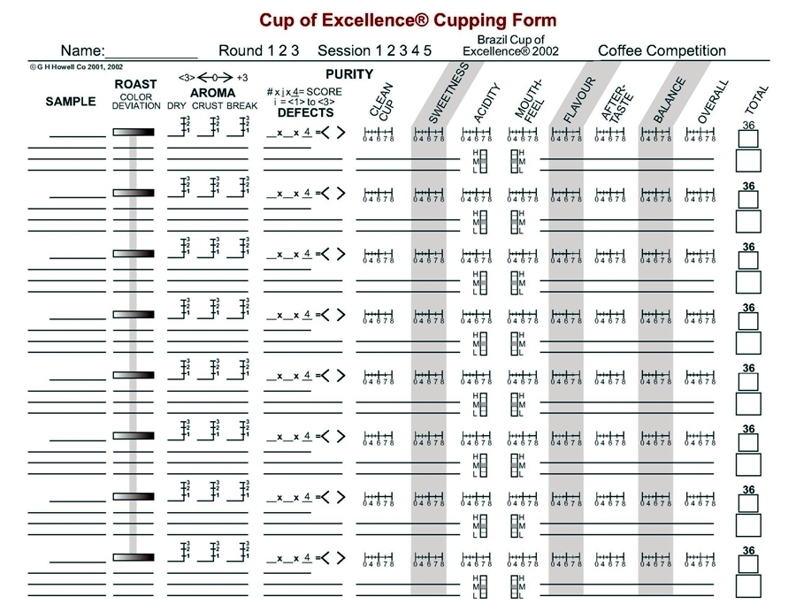

Slide 9
맛의 감별
In common
Clean cup and Sweetness are the most important things for Specialty Coffee
Issue
Aroma, Score or Not!
Body vs Mouthfeel
Balance vs Complexity
Overall, Double check?
맛의 다양성
긍정적인 맛 – Complex (복합적인), Fine (순수하고 맑은), Delicate (섬세하고 미묘한)
Vibrant (경쾌한), Brightness (밝은), Lively (생동감), Persistent (지속적인),
Lingering (여운이 있는), Long aftertaste (뒷맛이 긴)
부정적인 맛 – Sour (시큼한), Harsh (거친), Acrid (자극적인), Acetic (식초같은), Rancid (역한)
Astringent (드라이한), Short (짧은), Metallic (금속 느낌), Unplesant (불쾌한),
Bland (밋밋한), Flat (빈약한), Pungent (찌르는듯한), Sharp (날카로운), Over fermented (과발효)

Slide 10
Aroma/Flavor/Aftertaste
Butter, Brown sugar, Caramel, Honey, Sugar cane,
Red apple, Herbal
Aftertaste
Short,Dry, Pungent (Too spicy), Astringent
Long, Persistent, Lingering
All day long, Long finish
Acidity
Acetic, Sour, Sharp
Crispy, Refreshing, Refined
Bright, Tartaric acid. Citric, Malic.
Lemon zest, Ripe Fruits
Body
Smooth, Sticky mouth, Silky mouth feel, Creamy,
Soft, Syrupy body
Balance
Well Balanced, Structured, Articulated
Multidimensional
Cleancup
Transparent, Crystal
Overall
Consistent, Well pronounced, Complex
Lush, Delicate

Slide 11
Aroma/Flavor : Lavender, jasmine, rose, honeydew, bergamot, mango, black currant, lemon peel, vanilla, maple syrup, white prunes, caramel apple
Acidity : Tartaric, malic, very complex, refined, soothing acidity
Other : Starts as a red apple and turns into a green as cooled, rounded and structured, delicate, syrupy, transparent
Aroma/Flavor : Jasmine, peach, lavender, apricot, pear jam, dry cherries, white grape, brown sugar, ripe apple, bergamot, passionfruit, black currant, lychee, blueberries, watermelon
Acidity : Tartaric, citric, sparkling
Other : Earl grey tea, exotic, super clean, intense sweet, long aftertaste
Aroma/Flavor : Mulberry, mango, tangerine, apricot, peach, lychee, black currant, grapefruit, raspberry
Acidity : Malic, orange, lemon, juicy, clean, refined
Other : Cocoa finish, very sweet, long sweet finish, velvety mouthfeel, multidimensional
Aroma/Flavor : Cinnamon, nutmeg, stewed apple, gingerbread, cantaloupe, red apple, plain yogurt, coconut, prunes, raisins, apple pie
Acidity : Lactic, compelling, citric, malic
Other : Rich body, long aftertaste, polarizing, sweet spice aftertaste, chocolate aftertaste, exotic, creamy
Aroma/Flavor : Red grapes, passionfruit, pineapple, vanilla, lime, stone fruits, prunes, elderflower, red grapefruit, sugar cane, tangerine, black tea, cedar, tobacco leaf, winey, rose, whiskey
Acidity : Sparkling, citric, tartaric, phosphoric, refined, crisp
Other : Multidimensional, complex, lingering, very sweet, honey, super sweet, quenching

Slide 12
스파이시?
허브?
너티?

Slide 13
Special Cupping
COE vs Non COE
Scoring

Slide 14
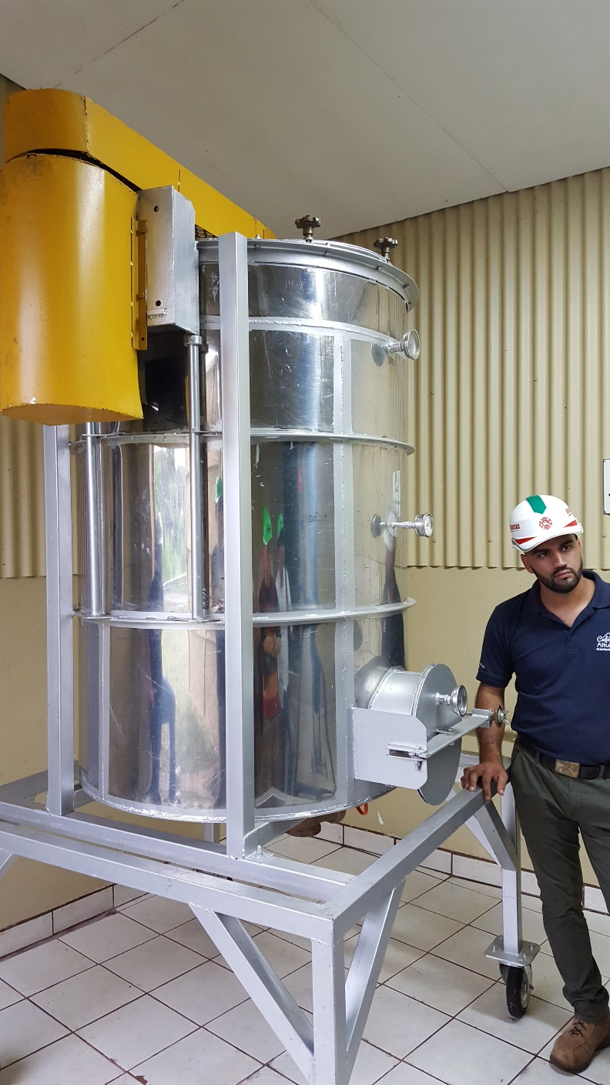
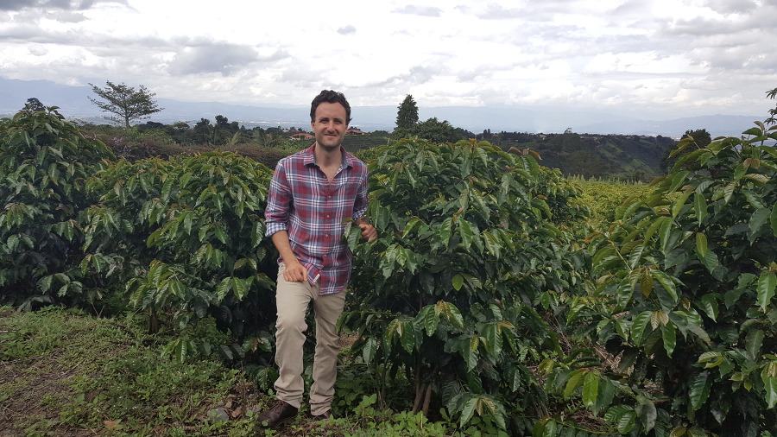

Slide 15
Costa Rica COE #8 El Diamante Anaerobic / 89.41
Aroma/Flavor : Brown sugar, cinnamon, clove, dark chocolate, molasses, lime juice, caramelized apple, strawberry, black tea, pear, anise, watermelon
Acidity : Tartaric, phosphoric, lactic
Other : Chocolate biscuit, full body, crisp
Costa Rica COE #36 Volcan Azul / 86.21
Aroma/Flavor : Honey, red grapes, Butter, pipe tobacco, dark chocolate, cocoa nibs, anise, cedar, menthol cigarettes, red apples, nuts
Acidity : Malic, tartaric, well structures, approachable
Other : Bold

